Slide 1

PROPERTY PRICE PREDICTION TO AGENCIES
GROUP 6
1. Nicole Bosibori
2. Monica Mwangi
3. Jane Njuguna
4. Shilton Soi
5. Loise Mburuga
This Photo by Unknown Author is licensed under CC BY-SA

Slide 2



Slide 3
OUTLINE
Project Overview
Objectives
Data Understanding
Data cleaning and preparation
Exploratory data analysis –Bivariate and Univariate analysis
Statistical Analysis
Modelling
Regression Results
Conclusion
Recommendations

Slide 4
PROJECT OVERVIEW
What is the problem
A real estate agency in King County seeks to provide advice to homeowners on how renovations could increase estimated value of their homes but lacks data.
How to solve the problem
Construct a predictive regression model that aids real estate agencies in empowering clients on making informed decisions on property prices

Slide 5
1. Identify Key Factors Influencing House Prices
OBJECTIVES
2. Effectiveness ways to predicting house prices.
3. Provide suggestions to real estate agencies for enhancing profitability and market presence.

Slide 6
DATA UNDERSTANDING
21
columns/ features
This project uses the north western county dataset.
Integers which include;
id, bedrooms, sqft_living, sqft_lot, sqft_above, yr built , zipcode, sqft living15, sqft lot15
Float data types include;
price, bathrooms, floors, year renovated, latitudes and longitudes
Object data type include the columns;
date, waterfront, view, condition, grade and sqft basement.
Data time frame: 1900 - 2015
21597
records
3
categorical features
3 data types
This Photo by Unknown Author is licensed under CC BY-SA

Slide 7

DATA CLEANING & PREPARATION
Dropping irrelevant columns; id, date, longitude, latitude, zip code and waterfront.
Check and drop duplicates in the 'id' column.
Identify and handle missing values.
Check for place holders.
Convert data types if necessary.
Identify outliers.
Feature Engineering by creating new columns i.e ‘renovated'.
This Photo by Unknown Author is licensed under CC BY-SA

Slide 8
Exploratory Data Analysis (EDA) is a crucial step in data analysis where the main goal is to understand the characteristics of the data at hand.
Depending on the number of variables being analyzed simultaneously, EDA can be classified into three main types:
1.Univariate
2.Bivariate
3.Multivariate
Exploratory Data Analysis

Slide 9
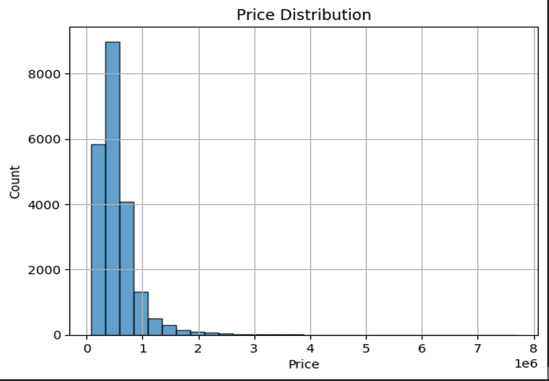
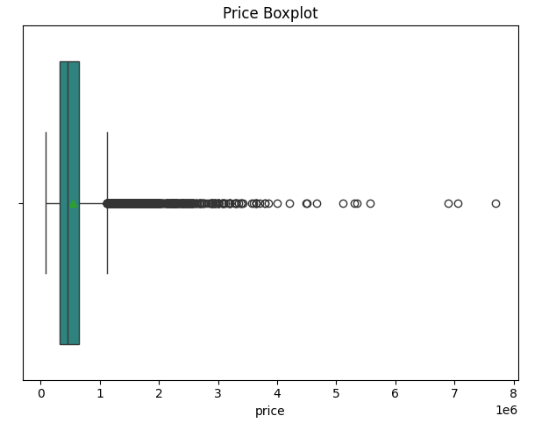

UNIVARIATE ANALYSIS – Price Distribution
This graph and boxplot shows the price distribution of houses and shows most houses cost less than 1000000

Slide 10
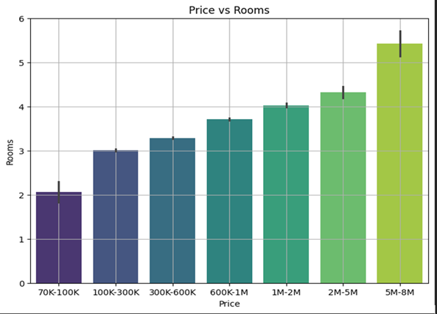
BIVARIATE ANALYSIS – Price vs Rooms
According to this graph, house prices increases with number of rooms, therefore houses with 5 or more rooms sell at around 5,000,000 while those with 2 or less rooms sell at around 70,000.
We can also conclude that most houses have less than 4 bedrooms and the ones that have 4 or more bedrooms cost more than 1,000,000

Slide 11
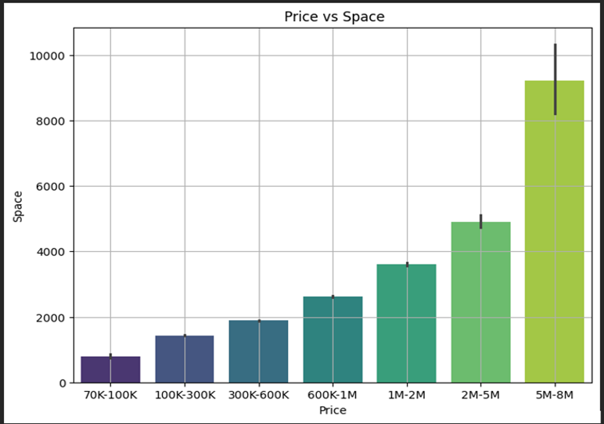
BIVARIATE ANALYSIS –Price vs Space
This graph shows that bigger houses tend to have a higher price, so a house worth about 90,000 is expected to be smaller than a house worth about 6,000,000.
We know that most houses cost less than 1,000,000 therefore, this indicates that most houses have less than 3000 square feet of living space and Houses with more than 4000 square feet of living space cost from 2,000,000
This Photo by Unknown Author is licensed under CC BY-SA

Slide 12
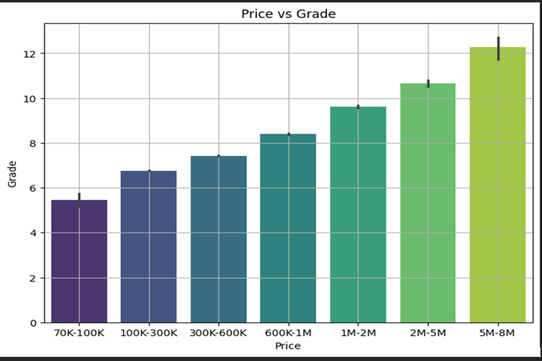
BIVARIATE ANALYSIS- Price vs Grade
Houses with higher grades tend to be of higher quality therefore they also have a higher price, for instance houses worth about 80,000 tend to have a lower grade (5 - 7) while houses worth about 6,000,000 tend to have a higher grade (12 - 13).
Since most houses cost less than 1,000,000, from this graph we can conclude that most houses have a grade of 7(average) and 8 (good)
This Photo by Unknown Author is licensed under CC BY-SA

Slide 13
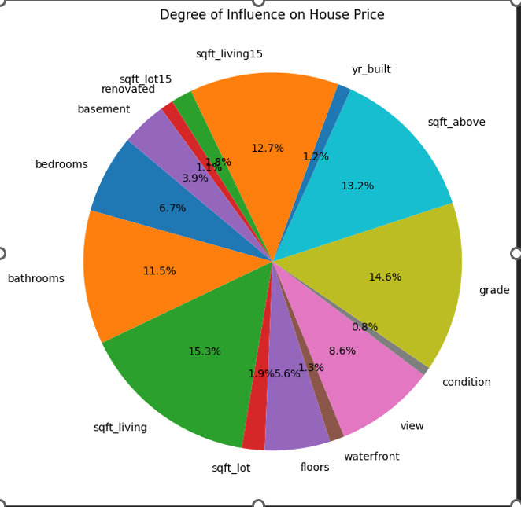
MULTIVARIATE ANALYSIS- PRICE VS ALL FEATURES
The pie chart shows what buyers in this area prioritize when looking to buy a house.
It indicates how much influence house variables have on the house price.
sqft_living has significant influence on price at 15.3%.
Renovation status has less significant influence on price at 1.1%
This Photo by Unknown Author is licensed under CC BY-SA

Slide 14
Statistical analysis is used to understand relationships within the dataset, identifying patterns, and gaining insights. In regression modeling project for predicting property value based on home renovations, here are the key steps in statistical analysis:
Descriptive Statistics
Correlation matrix
Distribution Analysis
Inferential Statistics using Hypothesis Testing and Analysis of Variance
Multicollinearity
STATISTICAL ANALYSIS

Slide 15
DESCRIPTIVE ANALYSIS
Understanding the characteristics of the data. The following were the conclusions from Mean, Mode, Variance and standard deviation
Price Distribution:
The prices of houses in the dataset vary widely, with a mean price of approximately 540,296.6 to 367,368.1. The prices range from 78,000 to 7,700,000.
Property Characteristics:
The dataset contains information on various property characteristics such as the number of bedrooms, bathrooms, square footage of living space, and lot size. For example, the average number of bedrooms is approximately 3.37, with a standard deviation of about 0.93.
Year Built:
The houses in the dataset were built between 1900 and 2015, with an average year of construction around 1971. The standard deviation indicates that there is some variability in the construction years.
Renovation:
The majority of houses have not been renovated, as indicated by the median value of 0 and the 75th percentile value of 0. The maximum renovation year is 2015.
This Photo by Unknown Author is licensed under CC BY-SA

Slide 16
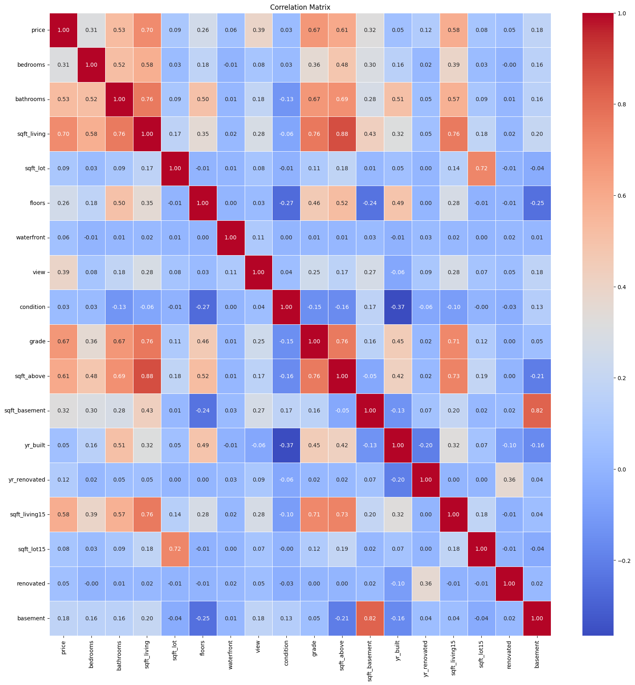
Correlation Matrix
Price has a moderate positive correlation with sqft living (0.76), sqft above (0.61), sqft basement (0.32), yr_built (0.45) and sqft living15 (0.71). This means that as the values of these features increase, the price of the house also tends to increase.
There is a weak positive correlation between price and bedrooms (0.31) and bathrooms (0.53).
Price has a weak negative correlation with yr_renovated (-0.05). It is important to note that correlation does not imply causation. Just because two features are correlated does not mean that one causes the other.
This Photo by Unknown Author is licensed under CC BY-SA

Slide 17
Distribution Analysis
We performed distribution analysis using Log transformation for a skewed distribution. Below are the conclusions;
Overall, the log transformation appears to have effectively reduced the skewness in the numerical variables, making their distributions more symmetric and suitable for statistical analysis.
However, it's important to note that the transformation alters the scale and interpretation of the variables, so further analysis should be conducted accordingly.
This Photo by Unknown Author is licensed under CC BY-SA

Slide 18
Inferential Statistics using Hypothesis Testing and Analysis of Variance
We performed a hypothesis test and results were as follows;
The features listed (bedrooms , bathrooms, square foot living, floors, year built, square foot above square foot living 15, basement, grade , view, condition,) under "Reject the Null Hypothesis" have a statistically significant relationship with housing prices.
On the other hand, features listed(square foot lot, renovated, square foot lot 15, waterfront) under "Fail to Reject the Null Hypothesis" do not show a statistically significant relationship with housing prices based on the ANOVA test.
These features are important predictors of housing prices in the given dataset.
This Photo by Unknown Author is licensed under CC BY-SA

Slide 19
Multicollinearity
Conclusion
The analysis reveals significant multicollinearity among several features, notably 'sqft_living', 'sqft_above', 'grade', 'yr_built', and 'sqft_basement', with VIF values exceeding commonly accepted thresholds.
This indicates strong correlations among these variables, potentially leading to unstable coefficient estimates and reduced interpretability in regression models.
Consideration should be given to dropping or combining these features, implementing dimensionality reduction techniques, or applying regularization methods to mitigate multicollinearity effects and improve model performance.
This Photo by Unknown Author is licensed under CC BY-SA

Slide 20
We demonstrated the three models in the notebook as stated below but we will recommend only polynomial because it is the most suitable regression model to analyze the prices for a more accurate output.
Baseline Model
Polynomial Regression
Log Transformation
Data Modelling

Slide 21
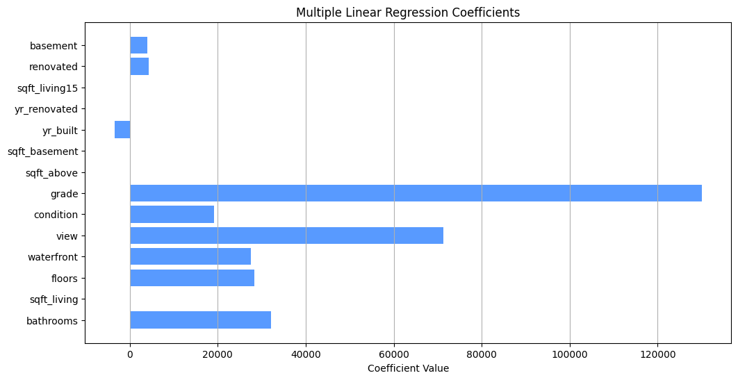
Polynomial regression
Polynomial regression involves converting features into higher-order polynomial terms. Key features demonstrate significant impacts on prices near relationships by utilizing multiple linear regression techniques
From the graph, a high R-squared value, attention is warranted regarding potential multicollinearity issues indicated by some coefficients' p-values.
Moving forward, leveraging these findings can enhance decision-making processes, refine marketing strategies, and empower clients to make well-informed investment choices in the dynamic real estate market.
This Photo by Unknown Author is licensed under CC BY-SA

Slide 22
Regression Results
Conclusion
Polynomial Regression is the preferred model because from the evaluation it has the highest R-squared value of 0.71
The features below impact price such that an increase will cause an increase in the price of the property. bedrooms, bathrooms, square foot living, floors, waterfront, view, condition, grade, square above, square foot basement', year renovated', 'sqft_living15','renovated', 'basement’.
On the other hand year built has a negative impact on price since the older the house the lower value it has which is shown by its negative coefficient.
This Photo by Unknown Author is licensed under CC BY-SA

Slide 23

CONCLUSIONS
Limitations
The dataset could have more property based characteristics.
Multicollinearity: The presence of correlated predictors (e.g., square footage and number of bedrooms) can lead to multicollinearity issues, making it challenging to interpret the individual effects of each feature accurately.
Assumption Violations: Polynomial regression assumes linearity between predictors and the target variable, which may not hold true in all cases. Violations of this assumption can lead to biased estimates and unreliable predictions.
Overfitting: Polynomial regression models, particularly those with high degrees, are susceptible to overfitting, where the model fits the training data too closely and may not generalize well to unseen data.
Overall the model was the best fit model for this prediction

Slide 24
RECOMMENDATIONS
Feature Enrichment: Enhance the dataset with additional property-based characteristics like property to amenities and architectural style to provide a more comprehensive understanding of factors influencing house prices.
Multicollinearity Management: Address multicollinearity by employing techniques such as feature selection, principal component analysis (PCA), or regularization methods like ridge regression or Lasso regression to prioritize important predictors and stabilize the model's interpretability.
Assumption Validation: Before using polynomial regression, verify the linearity assumption between predictors and the target variable. If non-linearity is observed, explore alternative regression techniques like generalized additive models (GAMs) or spline regression for better capturing complex relationships.
Overfitting Prevention: Prevent overfitting by balancing model complexity and generalizability through techniques such as cross-validation, regularization, or model selection criteria. Consider collecting more data or using bootstrapping to improve robustness and reduce noise in the model.

Slide 25

RECOMMENDATIONS TO THE STAKEHOLDERS
Consider the influence of neighboring properties
Renovations can add value Pay attention to the year built
Consider the number of bedroom Focus on the square footage
Maintain the condition of the property

Slide 26

NEXT STEPS
Stay updated on market trends
Educate clients on the impact of features Stay informed about regulations and policies Collaborate with appraisers
Conduct thorough market analyses Provide renovation recommendations

Slide 27

Thank you!

